Slide 1
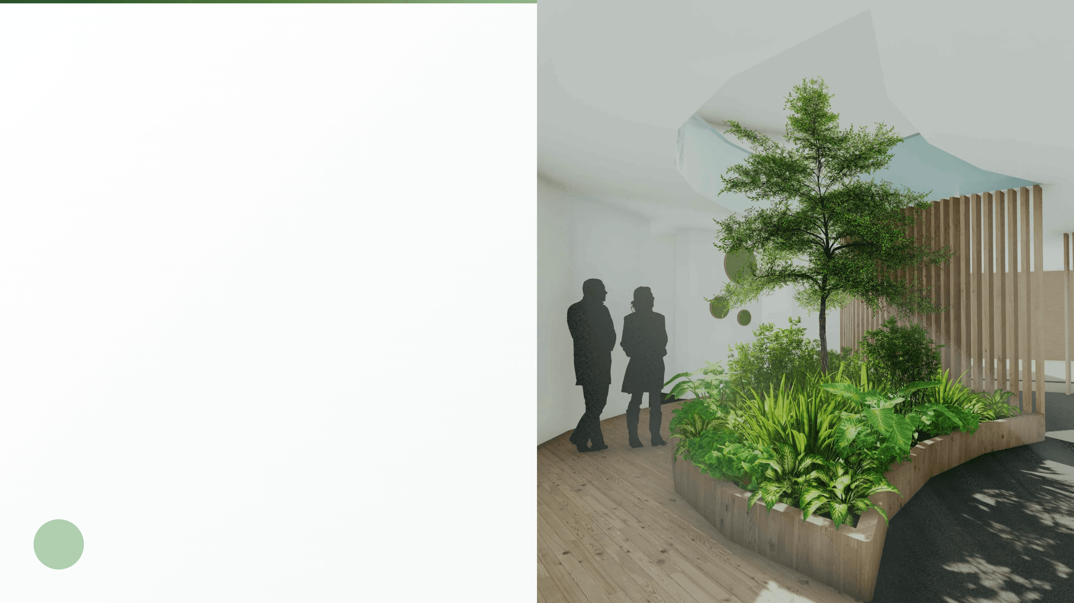
Environmental Biohacking & Biophilic Design
Optimizing Your Indoor Environment for Peak Health
Discover how integrating natural elements and biophilic design principles can reduce stress, enhance cognitive performance, and transform your living and working spaces into high-performance health sanctuaries.

Slide 2
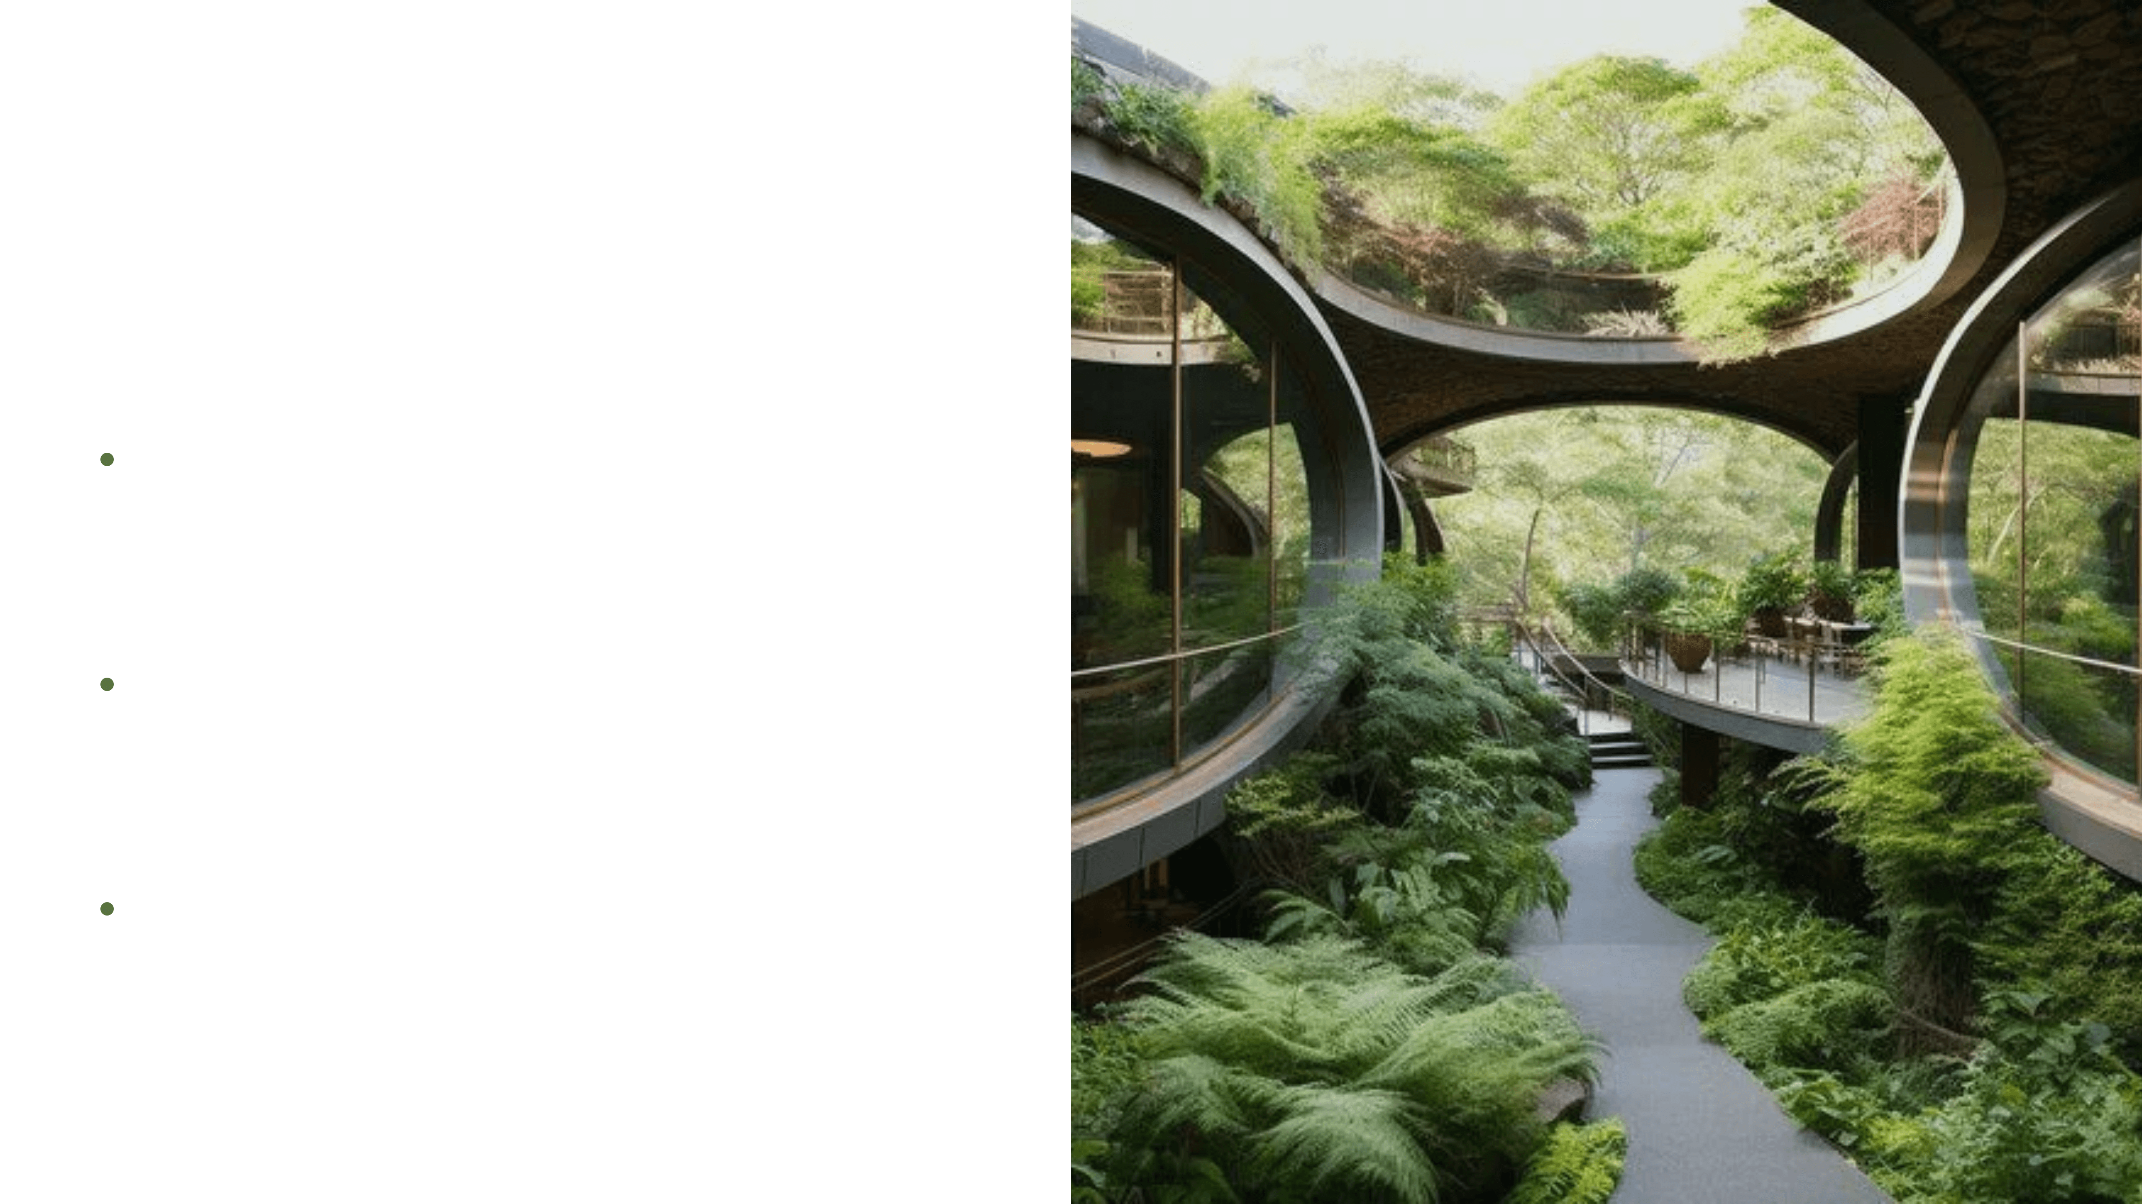
The Unseen Environment: Beyond Supplements
The Focus Shift
In biohacking, we often focus on what we put into our bodies—
supplements, specialized diets, and rigorous exercise. But what
about the environment we spend 90% of our time in?
Environmental Biohacking
The practice of optimizing your surroundings to enhance your
health, productivity, and well-being through strategic integration of
natural elements.
Biophilic Design
The most powerful, yet often overlooked, tool in the environmental
biohacking arsenal for transforming your indoor spaces.

Slide 3
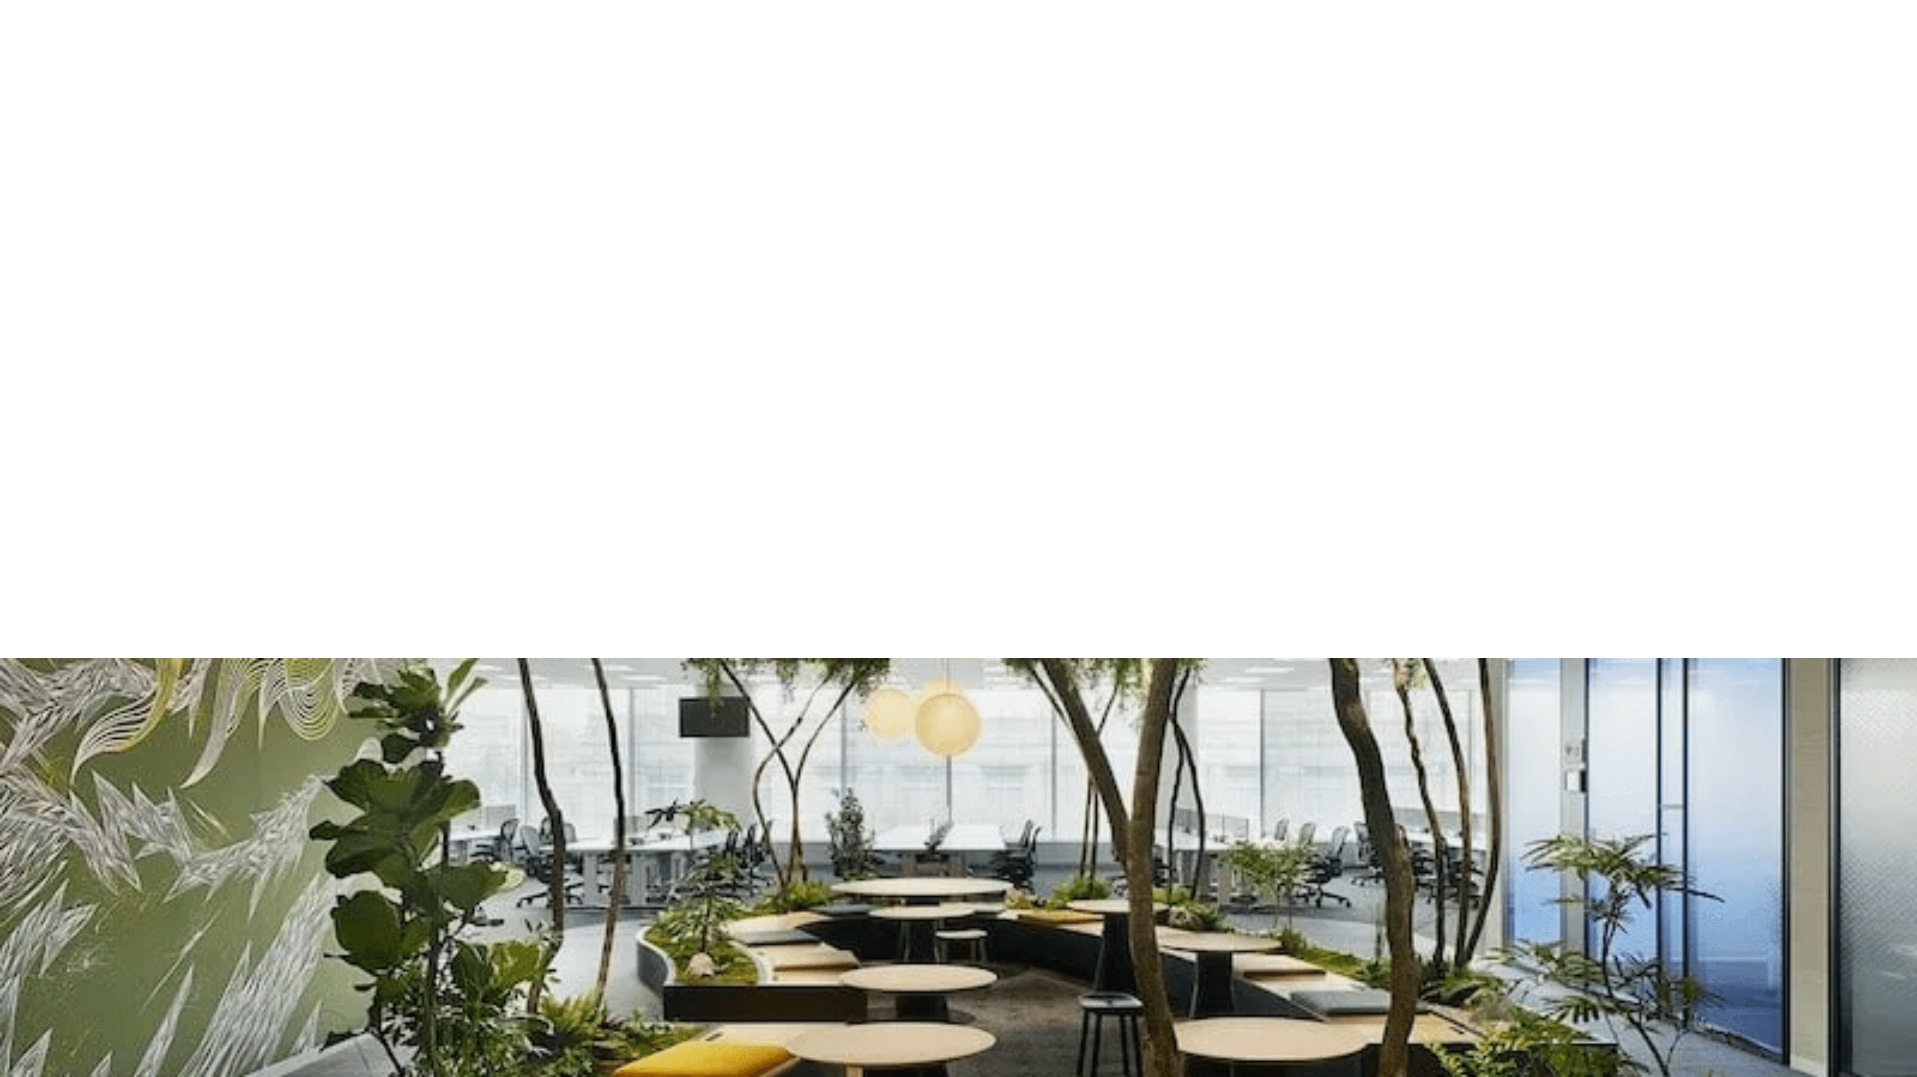
Biophilia: The Innate Human Connection to Nature
Definition
Application
Biophilia means "love of life"—the innate human tendency to seek connections with nature and other forms of life.
Translating this concept into our built environments by integrating natural elements into our homes and offices.
Key Elements
Physiological Impact
Natural light, water features, plants, natural materials like wood and stone, and organic patterns.
This isn't just interior decorating—it's a profound lifestyle factor that directly impacts your physiology and well-being.

Slide 4
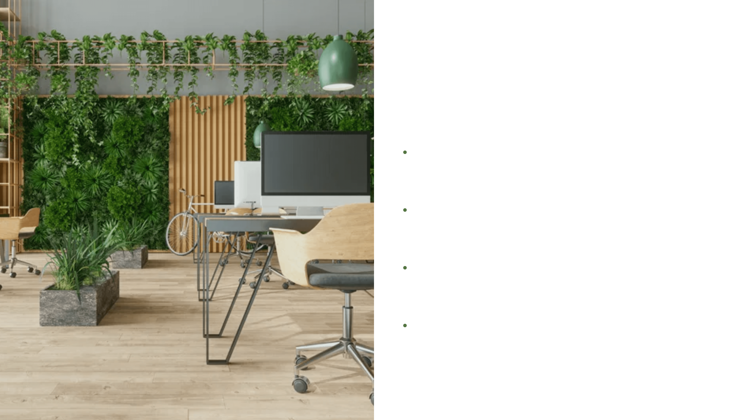
The Mental Health Hack: Stress Reduction Through Nature
The Problem
Our modern, often sterile, indoor spaces can trigger a low-level, chronic
stress response that impacts overall well-being.
The Solution
Introducing natural elements acts as a powerful counter-measure to this
chronic stress response.
Cortisol Reduction
Exposure to nature, even in the form of indoor plants and natural views,
significantly lowers levels of the stress hormone
cortisol
.
Measurable Outcomes
This leads to a measurable reduction in anxiety and an overall feeling of
calm and enhanced well-being.

Slide 5
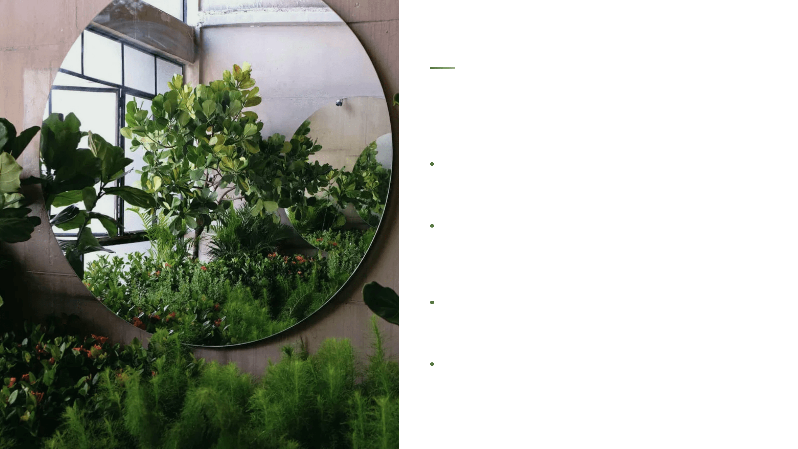
Cognitive Enhancement: Focus, Creativity, and Healing
Enhanced Focus
Biophilic elements help restore our attention capacity by allowing the
brain to recover from the fatigue of directed attention.
Cognitive Boost
Looking at natural scenes triggers a restorative process that leads to
improved focus, enhanced problem-solving skills, and increased
creativity.
Healing Effect
In clinical settings, patients with views of nature or plants in their rooms
report significantly less pain and require less pain medication.
Physiological Link
These findings demonstrate a direct physiological connection between
nature exposure and recovery, healing, and overall well-being.

Slide 6
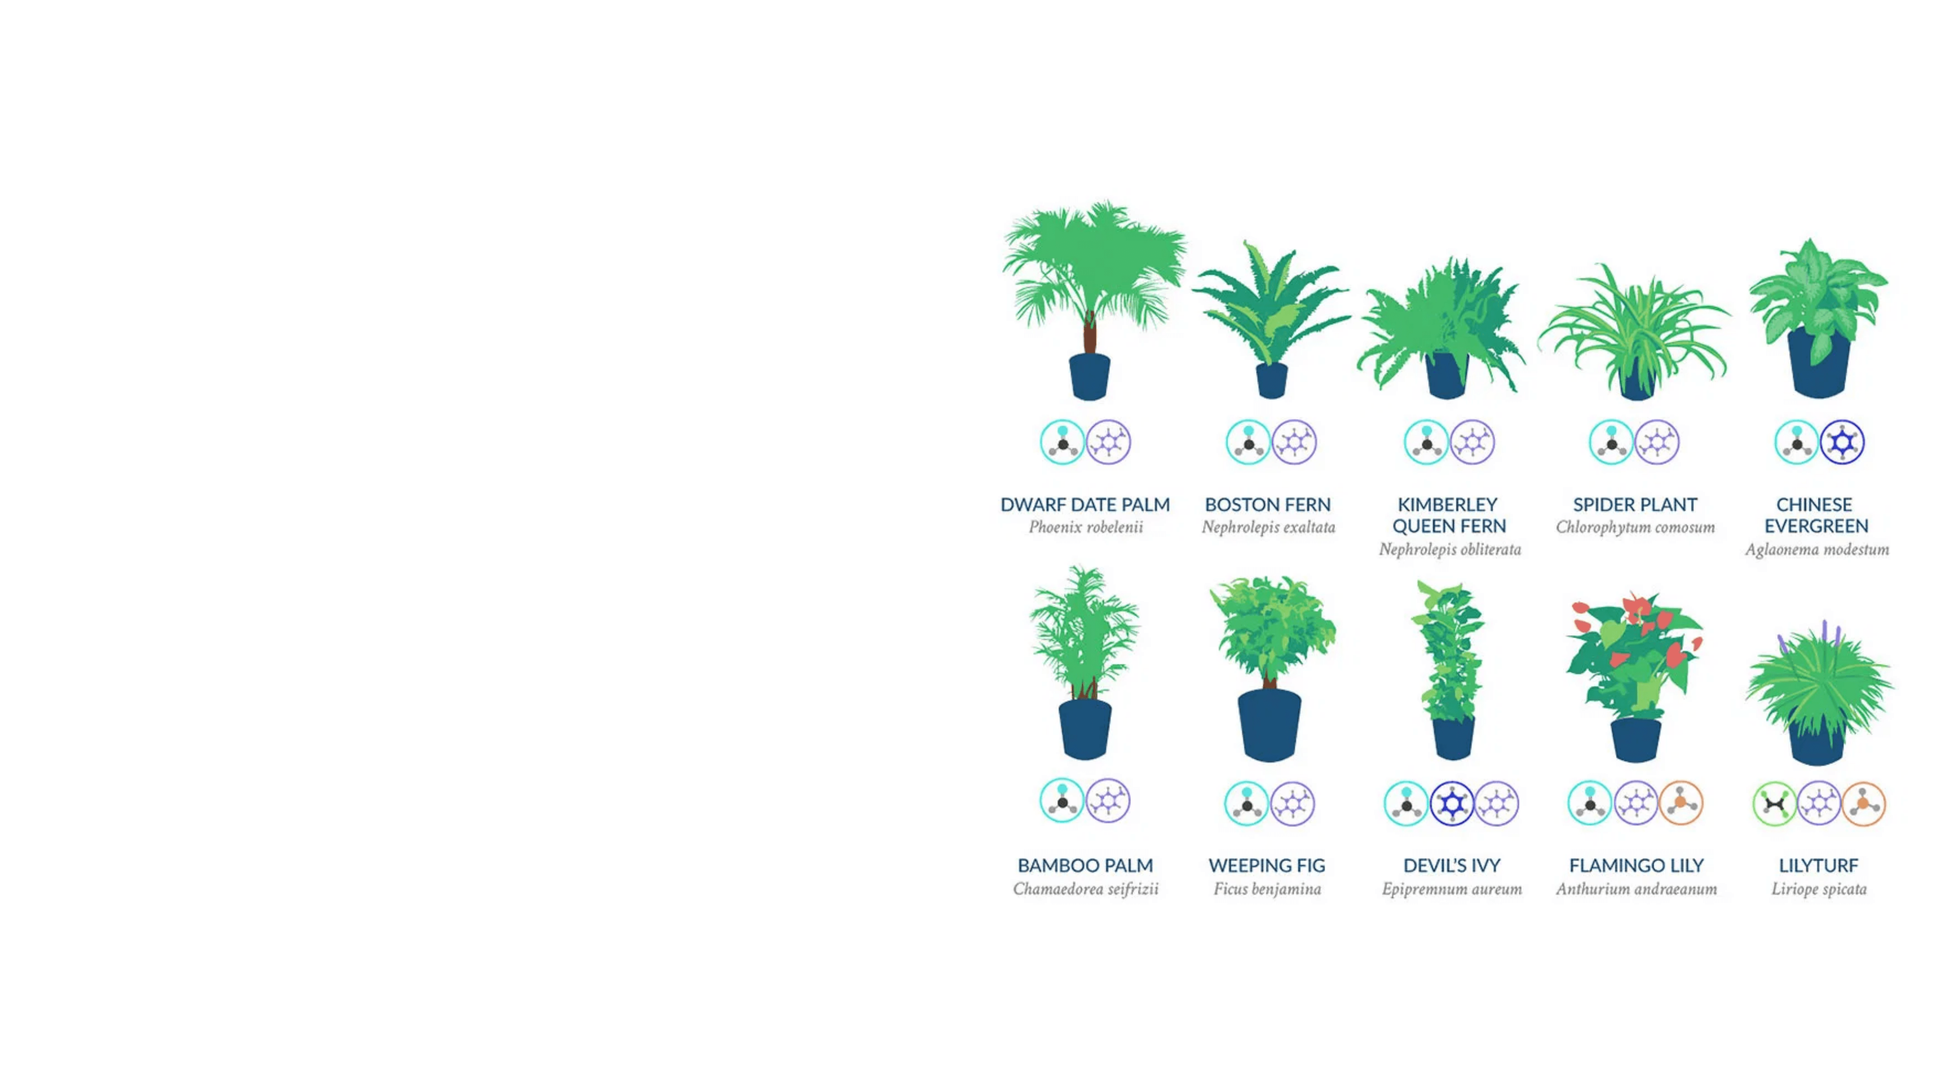
Air Quality: Separating Myth from Reality
The Myth
For decades, the idea that a few houseplants are powerful air purifiers has been widely accepted as fact.
The Origin
This belief largely stems from the 1989 NASA Clean Air Study, which showed that certain plants could effectively remove volatile organic compounds (VOCs) like formaldehyde and benzene.
The Nuance
The NASA study was conducted in a small, sealed chamber—a controlled environment very different from a typical home or office.
The Reality
In a typical, well-ventilated home or office, the rate at which air is exchanged and filtered often dwarfs the air-cleaning capacity of a few potted plants.

Slide 7
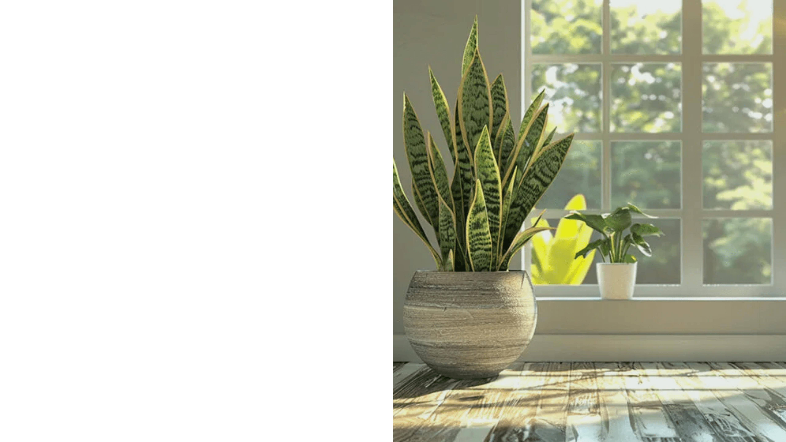
The True Benefits: Humidity, Perception & Microbial Diversity
1
Humidity Regulation
Plants naturally release moisture vapor, maintaining optimal indoor humidity levels.
Crucial for respiratory health and alleviating dry skin and throat issues.
2
Psychological Perception
The presence of plants makes us feel like the air is cleaner.
This perception contributes to the overall stress-reducing effect of biophilic design.
3
Microbial Diversity
Plants introduce beneficial microbes into the indoor environment.
Contributing to a healthier, more balanced ecosystem within your home.

Slide 8

Strategic Plant Placement: Volume Over Isolation
Focus on Volume
Instead of one or two plants, aim for clusters of greenery. The more vegetation, the greater the psychological impact and stress-reducing effect.
High-Impact Plants
Consider hardy, visually appealing species known for resilience: Snake Plants (Sansevieria), Pothos, and ZZ Plants. These thrive in various light conditions and provide maximum visual impact.
Natural Light Integration
Place plants where they can thrive, but also where they draw your eye toward natural light sources. This creates a visual connection to windows and outdoor elements.

Slide 9

Natural Materials & Textures: The Fractal Advantage
The Swap
Replace synthetic materials with natural alternatives. This simple shift can dramatically enhance the biophilic quality of your space.
Natural Materials
Think wood, stone, cork, and natural fibers like wool and cotton. Each brings unique texture and warmth to your environment.
The Fractal Advantage
These materials possess a fractal complexity that is inherently pleasing to the human eye and mind. This mathematical pattern naturally attracts our attention and creates visual harmony.
Natural Patterns
Introduce patterns that mimic nature: wood grain, stone veining, or abstract representations of waves and clouds. These patterns reinforce the biophilic connection.

Slide 10

Optimize Light & View: Circadian Alignment and Connection
1
3
Maximize Natural Light
The "View" Effect
Keep windows clean and unobstructed. Natural light is the most powerful regulator of your internal biological clock and energy levels throughout the day.
Arrange your furniture so that your primary working or resting spot offers a view of nature—whether it's a window to a tree or a carefully curated indoor plant display.
2
4
Circadian Rhythm Regulation
Continuous Connection
Natural light regulates your circadian rhythm, which is fundamental to sleep quality, energy levels, and mood stability. This is one of the most powerful biohacks available.
Both natural windows and indoor plant displays create biophilic connection. The key is ensuring your primary spaces offer visual access to nature throughout your day.

Slide 11

Your Home is Your Health Lab: Start Your Biohacking Journey
Environmental biohacking through biophilic design is a low-cost, high-impact way to optimize your health from the outside in.
1
Buy a new plant — Start with a hardy species like a Snake Plant or Pothos for immediate biophilic impact.
2
Rearrange your desk — Position your workspace to face a window or plant display for continuous nature connection.
3
Swap one item — Replace a plastic item with a wooden or natural material alternative to enhance your space.
Your environment is your health lab. Biohack it wisely.
By consciously integrating the power of plants and natural elements into your indoor spaces, you are actively reducing stress, improving focus, and creating a restorative sanctuary for optimal health and performance.

