Slide 1

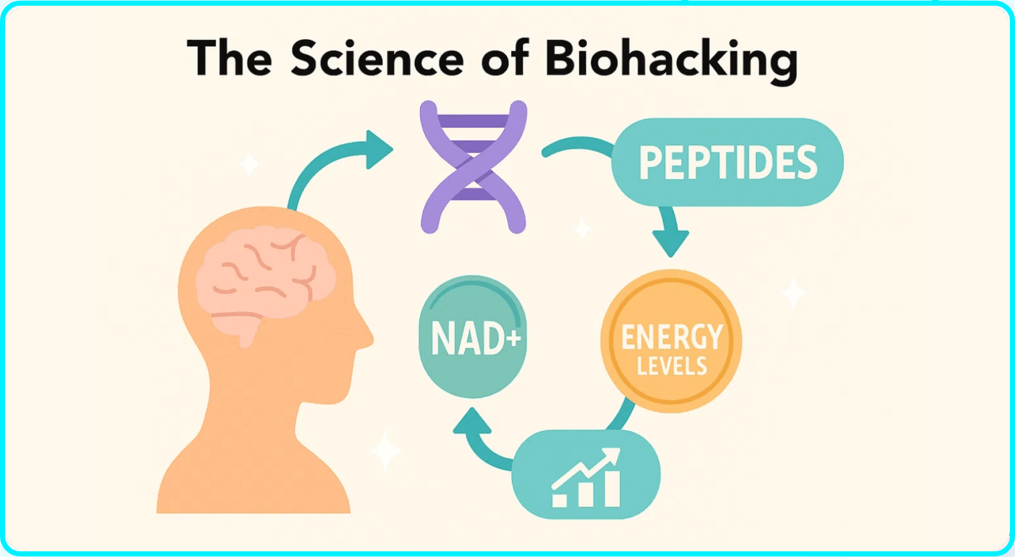
The Biohacker's Guide to Essential Supplements
Unlock Your Full Potential
Science-Backed Supplements to Optimize Your Biology, Enhance Performance & Build Resilience
fitonear.com

Slide 2






Strategic Supplementation Powers Peak Performance
Fill Nutritional Gaps
Modern diets often lack essential nutrients needed for optimal cellular function and energy production
Enhance Cognitive Function
Targeted supplements support brain health, focus, memory, and mental clarity throughout the day
Build Stress Resilience
Adaptogenic compounds help your body adapt to physical and mental stress in our fast-paced world
Unlock New Performance Levels
Science-backed supplementation optimizes biology beyond what diet and exercise alone can achieve
In the world of biohacking, we track our sleep, experiment with our diets, and take cold plunges—all in the name of optimizing our biology. Strategic supplementation is one of the most powerful tools in our arsenal.

Slide 3

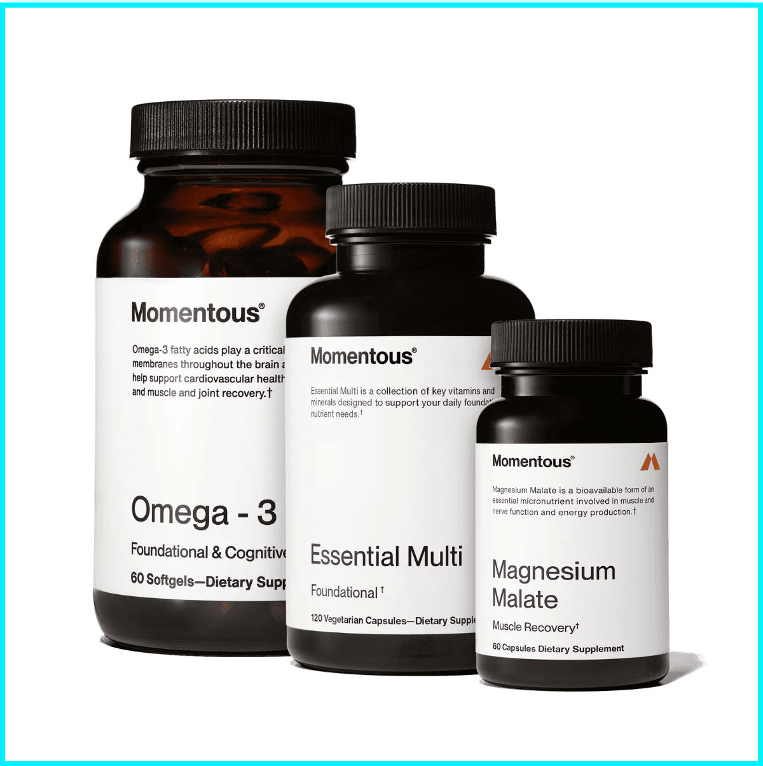



The Foundational Five - Your Non-Negotiable Daily Stack
1. Vitamin D3 + K2
1
The Sunshine and Director Duo
Crucial for immune function, mood regulation, and bone health. K2 directs calcium to bones and away from arteries. 2017 study confirms combined effect superior to either nutrient alone.
Shop on Amazon
2. Magnesium Glycinate
2
The Relaxation Mineral
Involved in over 300 enzymatic reactions in the body. Key role in muscle relaxation, sleep quality, and stress management. One of the most common nutrient deficiencies.
Shop on Amazon
3. Omega-3 Fatty Acids
3
Brain and Body Fuel
EPA and DHA critical for brain health and reducing inflammation. Supports cardiovascular function throughout all life stages.
Shop on Amazon

Slide 4

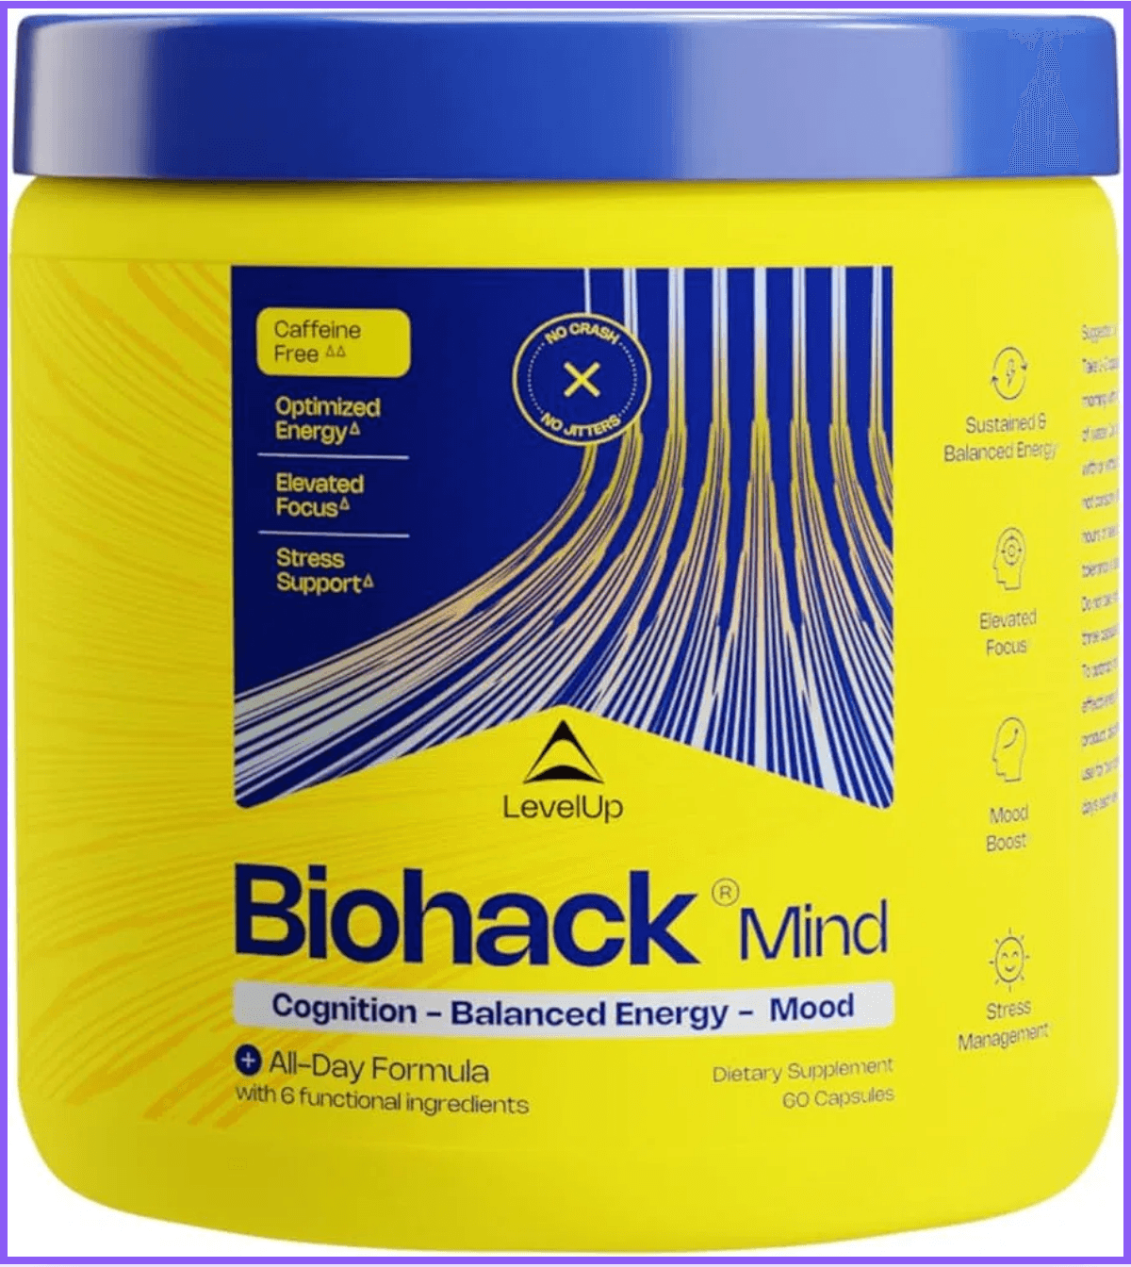

The Foundational Five - Complete Your Daily Stack
4. Creatine Monohydrate
4
More Than Just a Muscle Builder
Over 500 peer-reviewed studies validate effectiveness. Increases strength and muscle mass while emerging research shows significant cognitive benefits for brain health and mental performance.
Shop on Amazon
5. B-Complex
5
The Energy Igniters
Essential for energy metabolism, cellular function, and brain health. Complete family of B vitamins ensures you have the energy to power through your day with optimal cellular performance.
Shop on Amazon
Start with these five foundational supplements to build a solid base for your biohacking journey. These are your non-negotiables for optimal health and performance.

Slide 5




Next Level Biohacks - Performance & Longevity Boosters
1. CoQ10 (Ubiquinol)
1
Cellular Energy Powerhouse
Critical component of mitochondria (cellular powerhouses). Ubiquinol form is 8x more absorbable than standard ubiquinone. Supports cellular energy and cardiovascular health as natural production declines with age.
Shop on Amazon
2. NMN (NAD+ Booster)
2
The Anti-Aging Molecule
Essential for DNA repair, energy metabolism, and circadian rhythm maintenance. Effectively raises NAD+ levels that decline with age. Popular supplement for longevity and healthy aging support.
Shop on Amazon
3. Resveratrol
3
The Longevity Gene Activator
Powerful antioxidant found in red grapes. Activates sirtuins, often called "longevity genes." Supports healthy aging and cellular protection.
Shop on Amazon

Slide 6




Build Resilience with Adaptogens - Your Biohacking Blueprint
Ashwagandha
Rhodiola Rosea
The Ancient Stress Buster
The Fatigue Fighter
Long history in Ayurvedic medicine. KSM-66 extract significantly reduces cortisol (stress hormone). Clinically proven stress reduction.
Combats fatigue and improves mental performance under stress. 2010 study shows reduced fatigue in physicians on night duty.
Shop on Amazon
Shop on Amazon
Your Biohacking Blueprint
1
Start with the Foundational Five - Build your base
2
Add Performance & Longevity Boosters - Based on your goals
3
Incorporate Adaptogens - For stress resilience
4
Listen to Your Body - Adjust as needed for optimal results
Explore more science-backed biohacking guides at
fitonear.com
Start your optimization journey today! 🚀

