Slide 1


Biohack Your Blood Sugar
The Ultimate Guide to Continuous Glucose Monitors (CGM)
Transform Your Health with Real-Time Metabolic Insights
Visit fitOnear.com for more biohacking guides
Optimize Your Biology. Elevate Your Life.

Slide 2

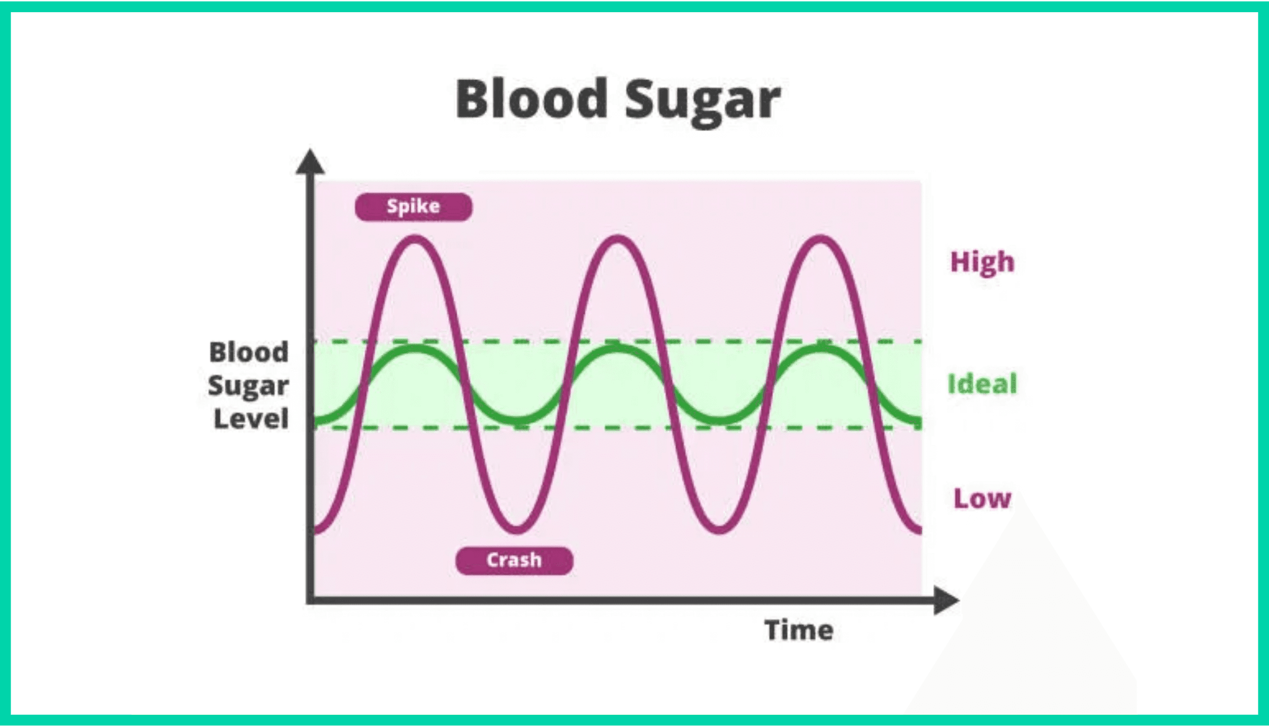
Are You Stuck on the Blood Sugar Rollercoaster?
Ever feel like your energy levels are unpredictable? One minute you're flying high, the next you're crashing hard and craving sugar. This exhausting cycle affects millions of health-conscious individuals daily.
Learn more at fitOnear.com

Slide 3

The Hidden Consequences of Blood Sugar Spikes
Energy Slumps & Brain Fog
Intense Cravings
That mid-afternoon crash directly linked to lunch choices. Your brain struggles to function optimally when blood sugar plummets.
Your body desperately seeking balance through quick-fix foods, creating a vicious cycle of spikes and crashes.
Chronic Inflammation
Accelerated Aging
Low-grade inflammation affecting overall health, from joint health to cardiovascular function.
Poor glucose control impacts cellular aging processes, potentially contributing to premature aging.
You don't need diabetes to benefit from understanding your blood sugar patterns
Learn more at fitOnear.com

Slide 4



CGM Technology Unlocks Your Metabolic Secrets
Think of a CGM as your personal metabolic detective, monitoring blood sugar levels 24/7 and revealing how your body responds to food, exercise, sleep, and stress in real-time.
Component
Function
Tiny filament under skin, painless, measures glucose, lasts 7-14 days
Sensor
Attaches to sensor, wirelessly sends data in real-time
Transmitter
Smartphone app showing trends, alerts, and patterns
Display Device
Unlike fingerstick tests that give single snapshots, CGMs provide continuous data streams—empowering you to make personalized, data-driven health decisions.
Discover your unique metabolism at fitOnear.com

Slide 5


Beyond Diabetes: CGM for Peak Performance & Longevity
A revolutionary shift is happening—athletes, biohackers, and health enthusiasts are using CGMs to optimize their metabolic health and unlock peak performance.
The Metabolic Flexibility Advantage
CGM data reveals your body's unique responses, enabling you to achieve metabolic flexibility—the ability to efficiently switch between burning carbs and fats for fuel.
Start your biohacking journey at fitOnear.com

Slide 6

From Guessing to Knowing: The CGM Data Advantage
From Guessing to Knowing
See exactly how a banana affects you versus a bagel
→
Understand how stress meetings impact your physiology
→
Identify your personal glucose triggers and stabilizers
→
Make informed decisions based on YOUR body's data
→
The Goal: Not perfection, but optimization through awareness and personalized insights
Start your biohacking journey at fitOnear.com

Slide 7

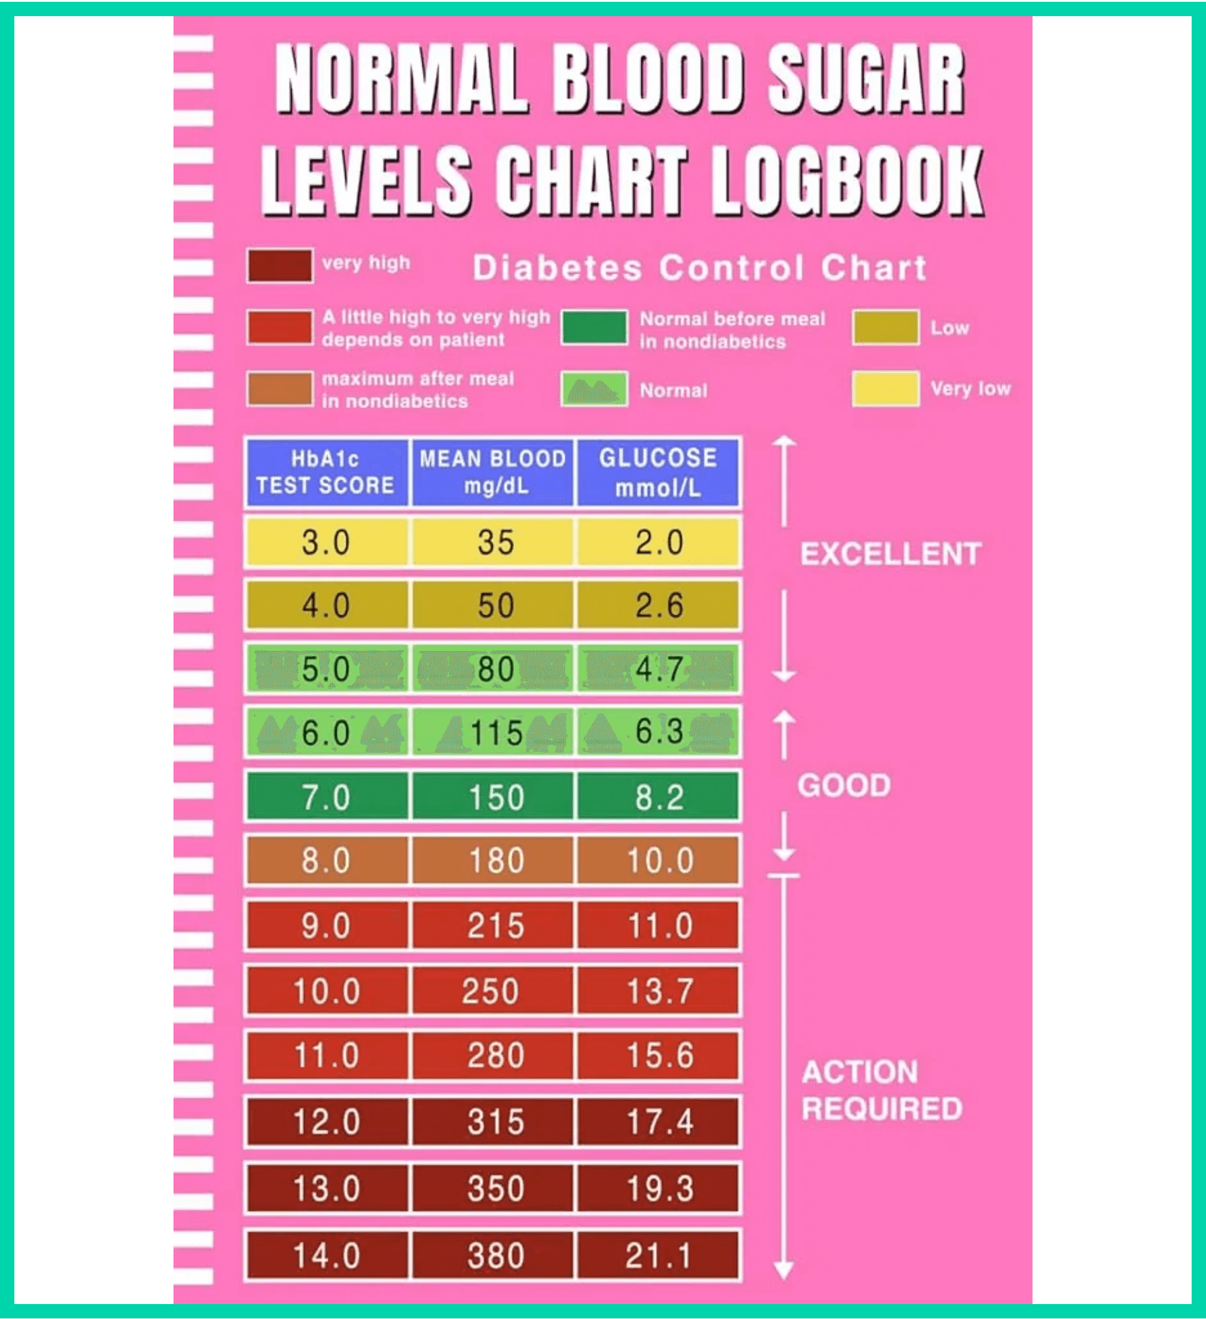
Understanding the Glucose-Insulin Connection
Your blood glucose levels are influenced by a complex interplay of factors, including the food you eat, your activity level, stress hormones, sleep quality, and even the time of day.
The Normal Process:
Carbohydrates break down into glucose → Enters bloodstream → Pancreas releases insulin → Glucose shuttles into cells for energy or storage → Blood sugar remains stable
Explore metabolic health at fitOnear.com

Slide 8

The Glucose Rollercoaster & Long-Term Risks
The Rollercoaster Problem:
Refined carbs or sugary foods → Dramatic blood sugar spike → Pancreas releases large insulin surge → Blood sugar drops too low → You feel tired, hungry, and crave more sugar
The Long-Term Risk:
Repeated spikes lead to insulin resistance—cells become less responsive to insulin, the first step toward prediabetes, type 2 diabetes, weight gain, inflammation, and cardiovascular disease.
CGM's Superpower:
Makes invisible metabolic processes visible, allowing you to experiment with strategies that minimize spikes and maintain stability for better energy, mental clarity, and long-term vitality.
Explore metabolic health at fitOnear.com

Slide 9

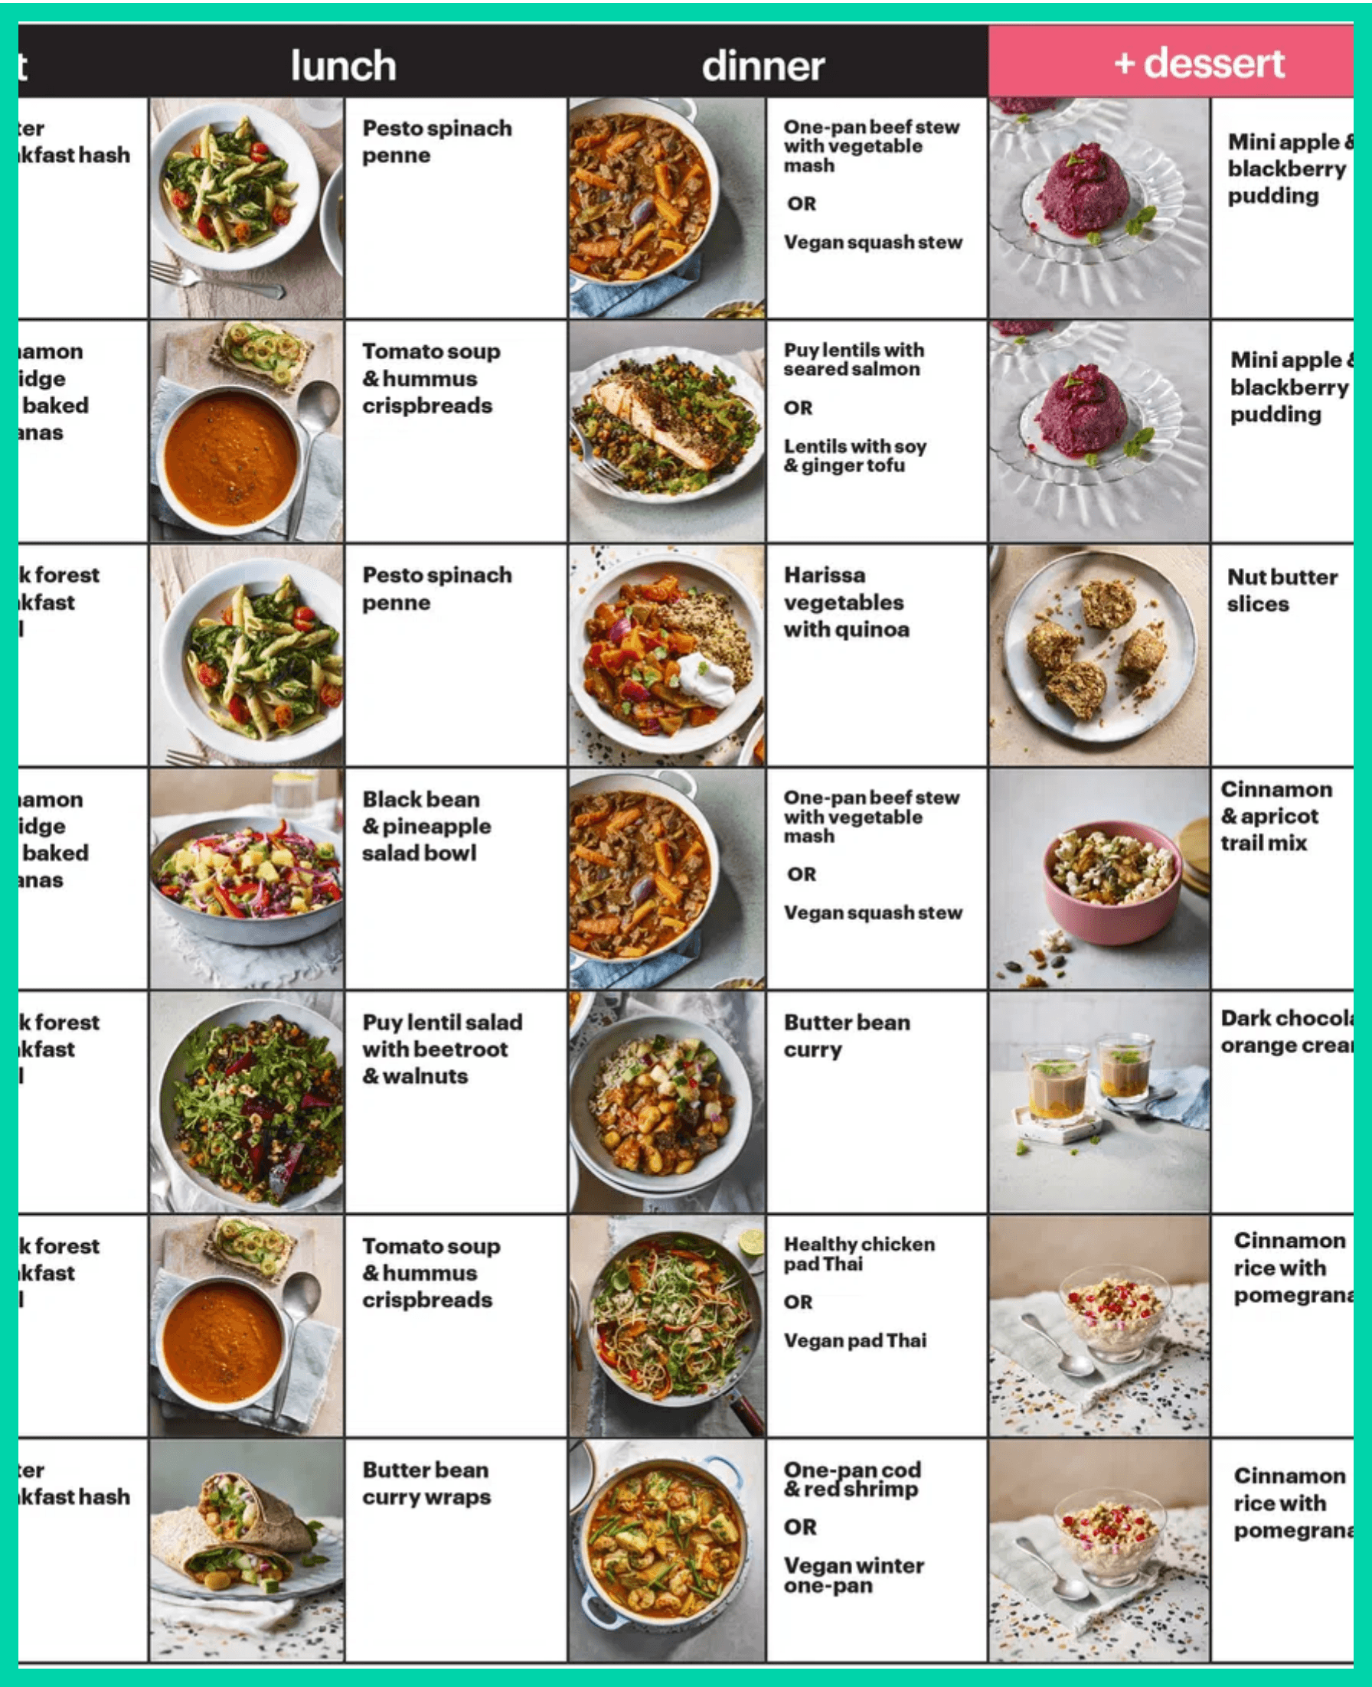
Use CGM Data to Discover Your Perfect Diet
You're now the lead scientist in your own health experiment. The goal: identify what sends your glucose soaring and what keeps it stable.
Test Individual Foods
Eat specific foods in isolation and monitor your two-hour glucose response. You might be surprised—some people spike from "healthy" oatmeal while others tolerate it perfectly.
Master Food Pairing
Experiment with combining carbohydrates with protein and healthy fats. The protein and fat slow glucose absorption, creating gradual, stable rises instead of sharp spikes.
Example: Apple alone vs. apple with almonds
Get personalized nutrition insights at fitOnear.com

Slide 10


Optimize Meal Timing & Portion Control with CGM
Optimize Meal Timing
Discover how time of day affects your glucose tolerance. Many people find their glucose response is better earlier in the day.
Does eating late at night cause bigger spikes for you?
Find Your Portion Sweet Spot
Use CGM data to identify ideal portion sizes. Enjoy your favorite foods in amounts that don't trigger problematic spikes.
Get personalized nutrition insights at fitOnear.com

Slide 11


Optimize Exercise Performance with Real-Time Data
Your CGM reveals how different workouts affect your glucose levels, enabling you to fine-tune your fitness routine for maximum results.
Pre- & Post-Workout Fuel Strategy
Monitor how your pre-workout meal affects energy and performance. Track glucose during and after exercise to understand how different workout types impact your levels. Cardio often drops glucose, while high-intensity training can temporarily raise it due to stress hormones.
Elevate your fitness at fitOnear.com

Slide 12

Strategic Timing & Recovery Optimization
Strategic Workout Timing
Experiment with exercising at different times or in relation to meals. A simple post-meal walk can significantly blunt glucose spikes—a powerful, accessible intervention.
Recovery Optimization
Stable glucose levels are crucial for recovery. Your CGM ensures you're refueling properly after tough sessions without overdoing carbohydrates, supporting muscle repair and growth.
The Performance Edge:
Data-driven training decisions lead to sustained energy, better endurance, and faster recovery times.
Elevate your fitness at fitOnear.com

Slide 13



How Sleep & Stress Impact Your Blood Sugar
Your CGM reveals surprising connections between sleep, stress, and metabolic health that you can't see otherwise.
The Overnight Test
Poor sleep wreaks havoc on blood sugar regulation. Check your overnight and morning glucose levels to see sleep quality's impact. After a poor night's sleep, morning glucose is often significantly higher than usual.
Stress Response Tracking
Notice an unexplained glucose spike? It could be stress. Monitor your levels during stressful meetings or situations to understand your body's physiological stress response. This awareness motivates incorporating stress-management techniques.
Circadian Rhythm Optimization
Your body's natural circadian rhythm profoundly affects glucose regulation. Use CGM data to understand your personal patterns and optimize eating and activity schedules accordingly.
Optimize your biology at fitOnear.com

Slide 14


Seven Lifestyle Changes to Maximize Results
1
Embrace Low-Glycemic, Whole-Foods Diet
Prioritize whole grains, lean proteins, healthy fats, nuts, seeds, and non-starchy vegetables. Your CGM quickly shows which foods are friends or foes.
2
Stay Consistently Hydrated
Dehydration raises blood sugar levels. Aim for 8+ glasses daily to help kidneys flush excess glucose.
3
Prioritize Regular Physical Activity
150+ minutes of moderate exercise weekly improves insulin sensitivity. Include both cardio and strength training.
4
Get Quality Sleep Every Night
7-9 hours of quality sleep prevents hormone disruption. Create consistent schedules and optimize your sleep environment.
5
Manage Stress Effectively
Chronic stress releases cortisol, raising blood sugar. Incorporate meditation, yoga, deep breathing, or nature time.
6
Follow Proper CGM Placement & Care
Apply sensors to recommended areas, change as instructed, keep clean, and protect from moisture for accurate readings.
7
Review & Act on Your Data Regularly
Actively review data, identify patterns, experiment with changes, and share reports with healthcare providers for additional insights.
Complete guide at fitOnear.com

Slide 15


Choose the Right CGM for Your Journey
Feature
Dexcom G7
FreeStyle Libre 3
Stelo
Wear Duration
10 days
14 days
15 days
Accuracy
Excellent (MARD 8.2%)
Excellent (MARD 7.9%)
Good
Real-Time Alerts
Yes
Yes
Yes
Best For
Athletes & biohackers seeking precision
Budget-conscious users wanting long wear
Non-diabetics exploring metabolic health
Amazon Link
View on Amazon
View on Amazon
View on Amazon
Find your perfect device at fitOnear.com

Slide 16


What Doctors Say About CGM for Non-Diabetics
The medical community offers a balanced perspective on CGM use for metabolic optimization, recognizing both benefits and potential concerns.
The Benefits
Early detection of prediabetes and metabolic dysfunction before clinical diagnosis. Empowers patients with data-driven lifestyle decisions that can prevent chronic disease progression.
The Concerns
Risk of overreacting to normal glucose fluctuations. Potential for creating unnecessary anxiety or obsessive behaviors around food and numbers without proper context.
The Bottom Line: Use CGM data as a tool for awareness and optimization, not perfection. Work with healthcare professionals to interpret results and make informed decisions.
Expert guidance at fitOnear.com

Slide 17

You Have the Power to Optimize Your Biology
The CGM Advantage
Transform invisible metabolic processes into actionable data
Make personalized decisions based on YOUR unique biology
Prevent chronic disease through early detection and intervention
Who Benefits from CGM?
Athletes optimizing performance • Biohackers seeking peak health • Weight loss journeys needing metabolic insights • Prediabetics preventing progression • Anyone curious about their metabolic health
The Bottom Line
Metabolic stability is the foundation of vibrant health, sustained energy, mental clarity, and longevity. CGM gives you the power to achieve it.
Take control at fitOnear.com

Slide 18


Ready to Transform Your Health with CGM?
1
Choose Your Device
Research options like Dexcom G7, FreeStyle Libre 3, or Stelo based on your goals and budget.
2
Consult Healthcare Professional
Discuss your metabolic health goals and obtain a prescription if required for your chosen device.
3
Start Your Experiment
Begin tracking your baseline glucose patterns and testing individual foods, meals, and activities.
Start your transformation at fitOnear.com

Slide 19

Your Path to Metabolic Optimization
4
Make Adjustments
Implement dietary, exercise, and lifestyle changes based on your personalized CGM data insights.
5
Monitor Your Progress
Track improvements in energy levels, mental clarity, body composition, and overall metabolic health over time.
Start your transformation at fitOnear.com

Slide 20

fitOnear.com
Your Partner in Metabolic Health Optimization
What You'll Find
● In-depth CGM guides and tutorials
● Evidence-based nutrition and fitness strategies
● Latest biohacking research and trends
● Community support and expert insights
Join the Biohacking Community Today
Visit fitOnear.com for more details

